Slide 1
Database Systems
Amrita University
9-<number>

Slide 2
Database Systems
Database Fundamentals
The Relational Model
9-<number>

Slide 3
Database Vs Flat File
A collection of data that is multidimensional in the sense that internal links between its entries make the information accessible from a variety of perspectives.
One-dimensional storage system, meaning that it presents its information from a single point of view.
9-<number>

Slide 4
Example
a flat file containing information about composers and their compositions might provide a list of compositions arranged by composer
a database might present
  all the works by a single composer,
  all the composers who wrote a particular type of music, and
  perhaps the composers who wrote variations of another composer’s work.
9-<number>

Slide 5
The Significance of Database Systems
database systems emerged as a means of integrating the information stored and maintained by a particular organization
  much of the information required by an organization was duplicated throughout the company
  many different but related items were stored in separate systems
9-<number>

Slide 6
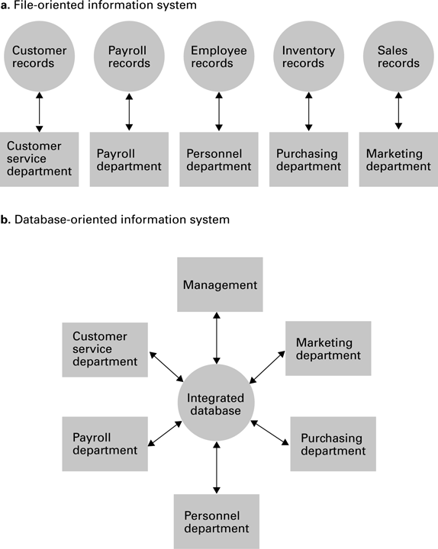
A file versus a database organization
9-<number>

Slide 7
Advantages of DBMS
With such a system,
  the same sales data could be used to produce restocking orders;
  create reports on market trends,
  direct advertisements, and
  product announcements to customers who are most likely to respond favourably to such information;
  generate bonus checks for members of the sales force.
9-<number>

Slide 8
Advantages of DBMS
Such integrated pools of information provided a valuable resource with which management decisions could be made, assuming the information could be accessed in a meaningful way.
9-<number>

Slide 9
Database Research
Focused on developing techniques by which
  the information in a database could be brought to the decision-making process.
  Much progress has been made in this regard.
Today, database technology, combined with data mining techniques, is an important management tool
  allows to extract pertinent information by management from enormous amounts of data covering all aspects of the organization and its environment.
9-<number>

Slide 10
The Significance of Database Systems
File versus a database organization.
Database technology + Data mining techniques and Big Data
Database technology + Web Interfaces
  Google, eBay, and Amazon
9-<number>

Slide 11
The Role of Schemas
Need for Schemas
  Sensitive data being accessed by unauthorized personnel
  Someone placing an order at a company’s website should not have access to the company’s financial data;
  an employee in a company’s benefits department may
  need access to the company’s employee records but should not have access to the corporation’s inventory or sales records
  the ability to control access to the information in the database is as important as the ability to share it.
9-<number>

Slide 12
The Role of Schemas
To provide different users access to different information within a database, database systems often rely on schemas and subschemas.
9-<number>

Slide 13
Schema and Sub Schema
Schema: A description of the structure of an entire database, used by database software to maintain the database.
Subschema: A description of only that portion of the database pertinent to a particular user’s needs, used to prevent sensitive data from being accessed by unauthorized personnel.
9-<number>

Slide 14
Schema Example: University Database
Each student record contains such items as the current address ,phone number addition to the student’s academic record.
It would indicate that each student record is linked to the record of the student’s faculty adviser.
The record for each faculty member would contain the person’s address, employment history, and so on.
Based on this schema, a linkage system would be maintained that ultimately connected the information about a student to the employment history of a faculty member.
9-<number>

Slide 15
Registrar’s and Payroll Depts Access
Registrar: access restricted to a subschema whose description of the faculty records does not include employment history.
Payroll department:
  would provide the employment history of each faculty member
  would not include the linkage between students and advisers.
  Could modify a faculty member’s salary
  could not obtain the names of the students advised by that faculty.
9-<number>

Slide 16
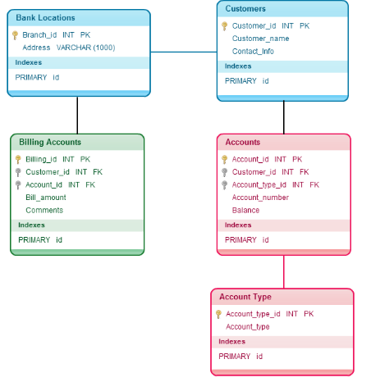
Example Schema: Bank Database Schema
9-<number>

Slide 17
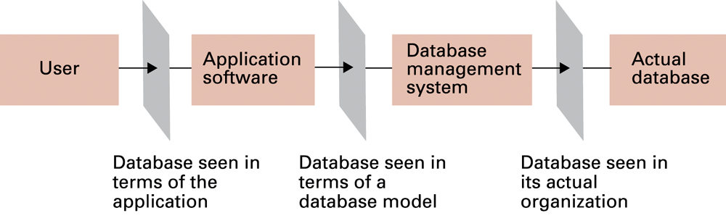
The conceptual layers of a database implementation
two major layers—
an application layer and
a database management layer
9-<number>

Slide 18
Database Management Systems
Application Layer: E.g., Users access a database by means of a website (Client/Server Model)
  Doesn’t directly manipulate the database
Database Management System (DBMS): A software layer that manipulates a database in response to requests from applications
Once the application software has determined what action the user is requesting, it uses the DBMS as an abstract tool to obtain the results.
Example: add or delete data, retrieve information
9-<number>

Slide 19
Abstraction by separating application software and DBMS
details of how the database is actually stored are isolated within the DBMS
design of the application software can be greatly simplified
application software is not concerned about whether the database is stored on a single machine or scattered among many machines
DBMS can enforce the restrictions imposed by the various subschemas
9-<number>

Slide 20
Data independence
The ability to change the organization of a database without changing the application software that uses it
For example, the personnel department might need to add an additional field to each employee’s record to indicate whether the corresponding employee chose to participate in the company’s new health insurance program.
9-<number>

Slide 21
Database Management Systems
Multiple software layers, which we will group into two major layers—an application layer and a database management layer.
Separation between the application software and the DBMS:
  The construction and use of abstract tools, which we have repeatedly found to be a major simplifying concept in software design -distributed database.
  Controlling access to the database.
  Avoids reprogramming.
9-<number>

Slide 22
Database Models
  DBMS : Abstraction : Hide the complexities of a database’s internal structure, allowing the user of the database to imagine that the information stored in the database is arranged in a more useful format.
  DBMS - routines : Translate commands - actions required by the actual data storage system
Database model: A conceptual view of a database
  Relational database model
  Object-oriented database model
9-<number>

Slide 23
Relational Database Model
Relation: A rectangular table with rows and columns
Attribute: A column in the table- column describes some characteristic, or attribute, of the entity represented by the corresponding tuple
Tuple: A row in the table
9-<number>

Slide 24
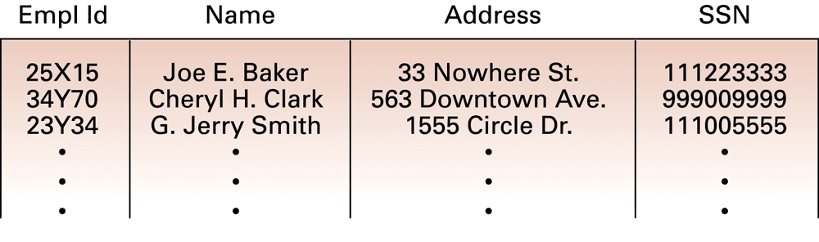
A relation containing employee information
9-<number>

Slide 25
Extending the Relation
Suppose we want to include information about the jobs held by the employees.
  job history associated with each employee
    consists of attributes such as job title (secretary, office manager, floor supervisor),
  A job identification code (unique to each job),
  the skill code associated with each job,
  the department in which the job exists, and
  the period during which the employee held the job in terms of a starting date and termination date.
    (We use an asterisk as the termination date if the job represents the employee’s current position.)
9-<number>

Slide 26
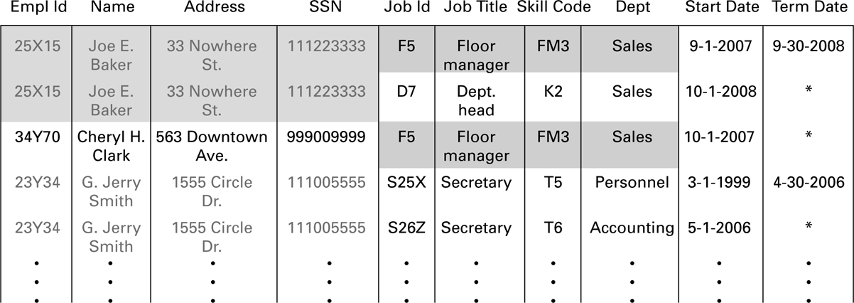
Solution
Include these attributes as additional columns in the table
9-<number>

Slide 27
Lack of Efficiency due to redundancy
relation no longer contains one tuple for each employee
one tuple for each assignment of an employee to a job
personal information about Baker and Smith is repeated because they have held more than one job
the description of the floor manager job is duplicated because more than one employee has held this position
9-<number>

Slide 28
Another Serious Problem
Deleting information from the database
Example : Joe E. Baker is the only employee to hold the job identified as D7.
  If he were to leave the company and be deleted from the database then
  we would lose the information about job D7.
  After all, it is the only tuple containing the fact that job D7 requires a skill level of K2 is the tuple relating to Joe Baker.
9-<number>

Slide 29
Relational Design
Avoid multiple concepts within one relation
  Can lead to redundant data
  Deleting a tuple could also delete necessary but unrelated information
9-<number>

Slide 30
A relation containing redundancy
contains information dealing directly with employees (name, identification number, address, Social Security number),
information about the jobs available in the company (job identification, job title, department, skill code), and
information regarding the relationship between employees and jobs (start date, termination date)
9-<number>

Slide 31
Improving a Relational Design
Decomposition: Dividing the columns of a relation into two or more relations, duplicating those columns necessary to maintain relationships
  Lossless or nonloss decomposition: A “correct” decomposition that does not lose any information
9-<number>

Slide 32
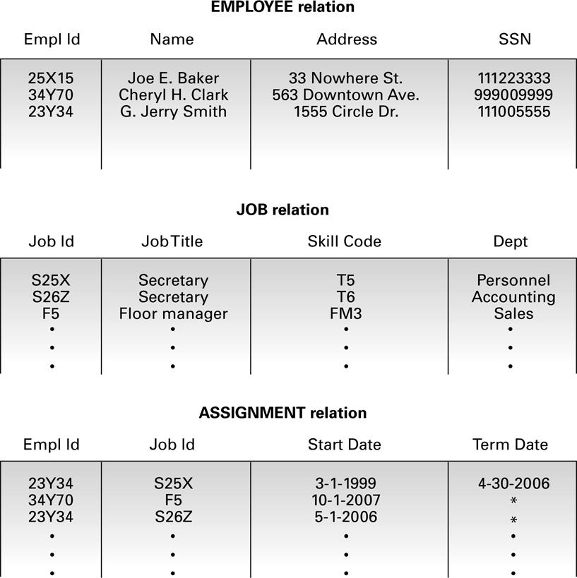
An employee database consisting of three relations
9-<number>

Slide 33
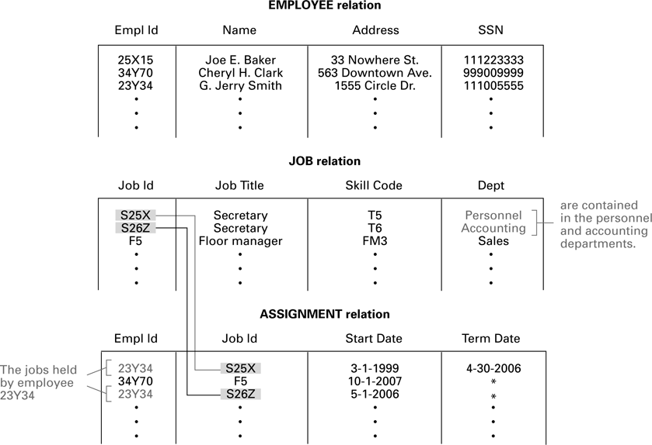
Finding the departments in which employee 23Y34 has worked
9-<number>

Slide 34
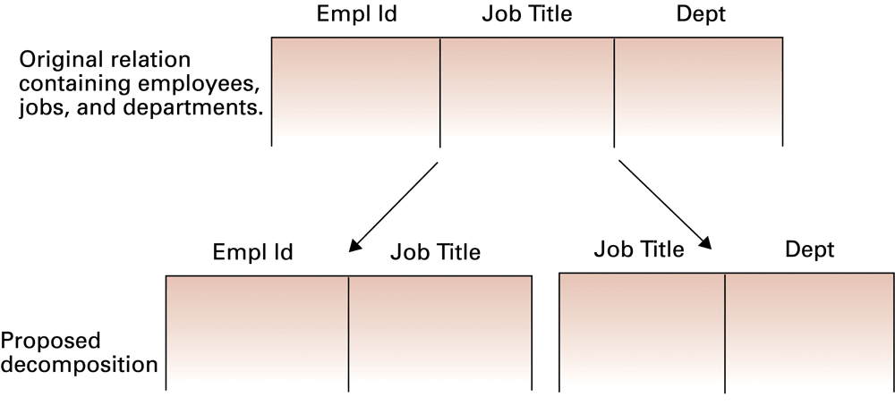
A relation and a proposed decomposition
9-<number>

Slide 35
Goals of Relation Model
To identify the relational characteristics that can lead to problems in database design.
Find ways to reorganize those relations to remove these problematic characteristics.
9-<number>

Slide 36
Relational Operations
Select: Choose rows
Project: Choose columns
Join: Assemble information from two or more relations
9-<number>

Slide 37
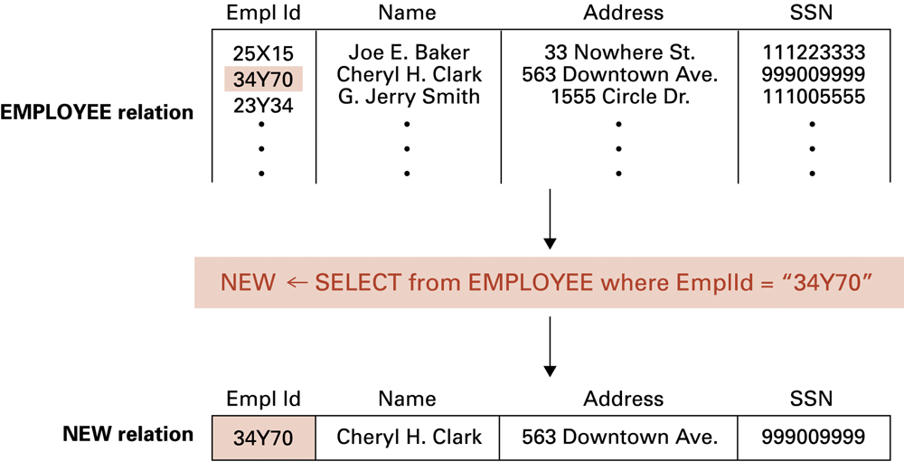
The SELECT operation
9-<number>

Slide 38
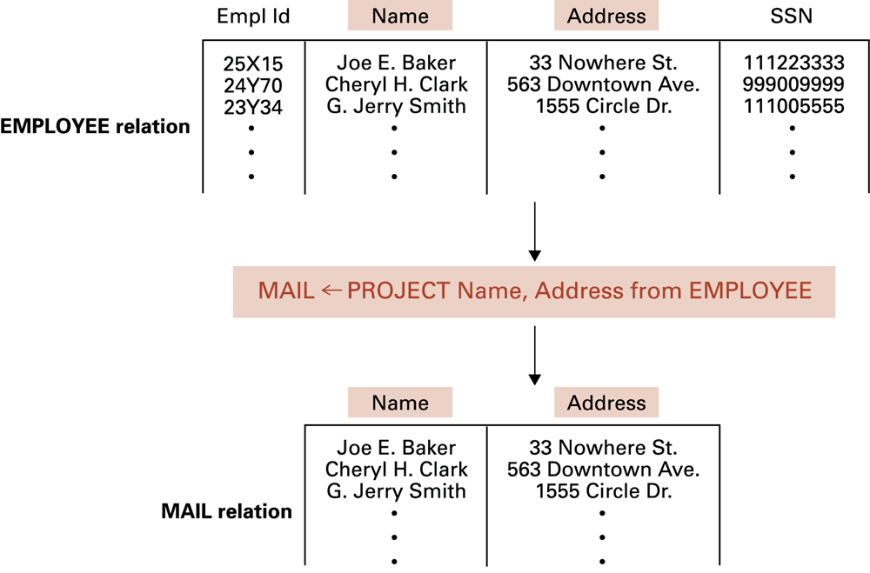
The PROJECT operation
9-<number>

Slide 39
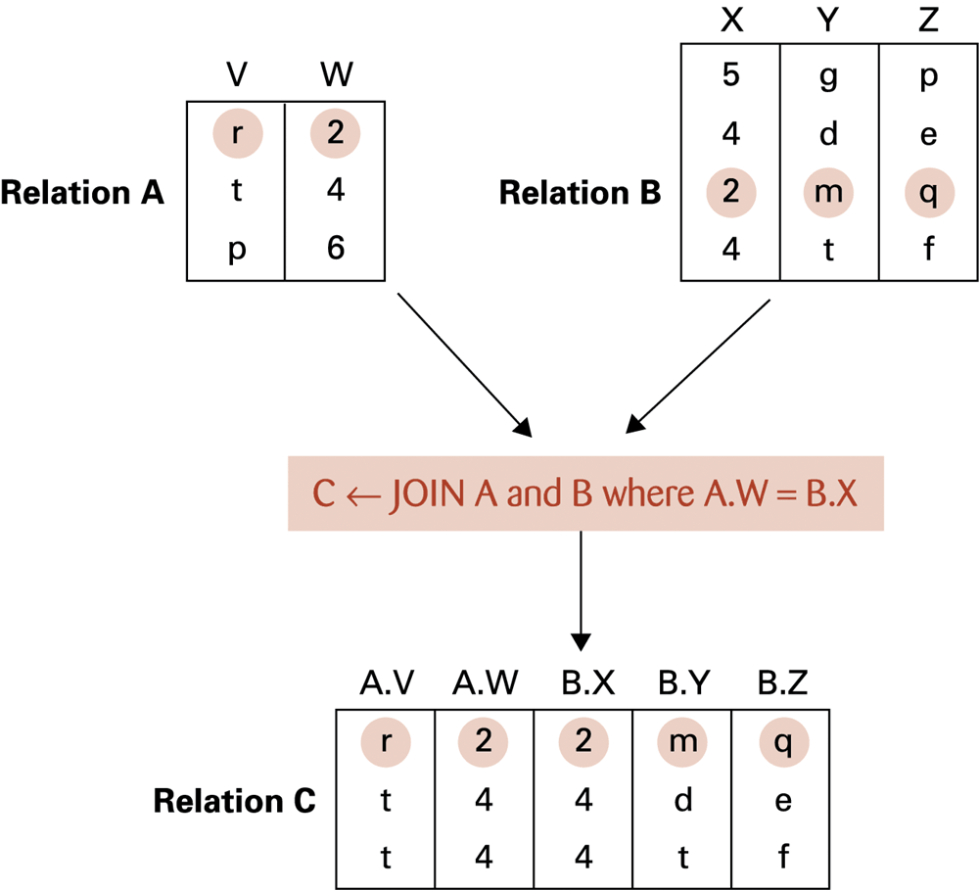
The JOIN operation
9-<number>

Slide 40
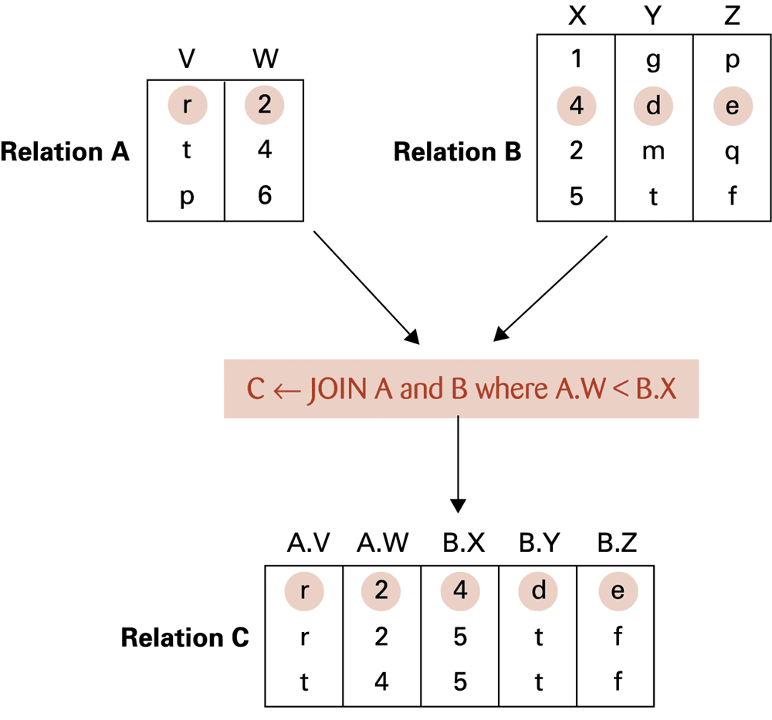
Another example of the JOIN operation
9-<number>

Slide 41
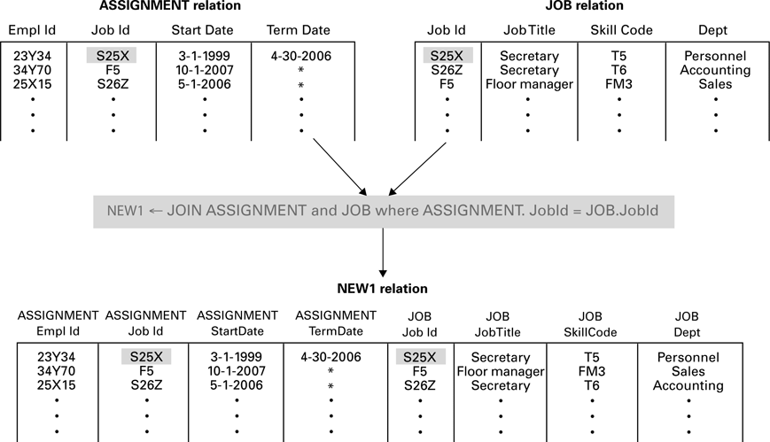
Listing of all employee identification numbers along with the department in which each employee works.
9-<number>

Slide 42
Listing of all employee identification numbers along with the department in which each employee works.
NEW1 ← JOIN ASSIGNMENT and JOB
where ASSIGNMENT.JobId = JOB.JobId
NEW2 ← SELECT from NEW1 where ASSIGNMENT.TermDate = '*‘
LIST ← PROJECT ASSIGNMENT.EmplId, JOB.Dept from NEW2
9-<number>

Slide 43
Structured Query Language (SQL)
Operations to manipulate tuples
  insert
  update
  delete
  select
9-<number>

Slide 44
Insert
INSERT INTO table_name
VALUES (value1,value2,value3,...);
insert into EMPLOYEE
values (‘43212’, ‘Sue A. Burt’,
’33 Fair St.’, ‘444661111’)
9-<number>

Slide 45
Update
UPDATE table_name
SET column1=value1,column2=value2,...
WHERE some_column=some_value;
update EMPLOYEE
set Address = ‘1812 Napoleon Ave.’ where Name = ‘Joe E. Baker’
9-<number>

Slide 46
Select
select A1, A2….An
from r1, r2…rm
where P
Ai : attribute
Ri : relation
P : predicate
SELECT clause- specifies the table columns retrieved.
FROM clause- specifies the tables to be accessed.
WHERE clause- which rows in the FROM tables to use.
9-<number>

Slide 47
SQL Examples
select EmplId, Dept
from ASSIGNMENT, JOB
where ASSIGNMENT.JobId = JOB.JobId
and ASSIGNMENT.TermData = “*”
9-<number>

Slide 48
Delete
DELETE FROM table_name
WHERE some_column=some_value;
delete from EMPLOYEE
where Name = ‘G. Jerry Smith’
9-<number>

Slide 49
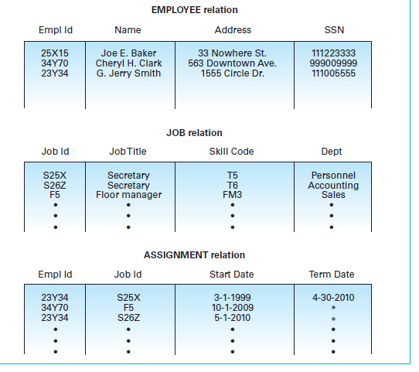
Review Questions
9-<number>

